Slide 1
Secure Service Discovery in open Networks
Author:
Markus Alexander Kuppe
Vitali Amann
http://github.com/lemmy/SecuredSLP
7. Juli 2009

Slide 2
Outline
Motivation
Open network
Discovery architectures
Service Location Protocol (SLPv2)
  Thread analysis SLPv2
Secure SLP
  Trust scenarios in open networks
  Security Groups
    Group Diffie-Hellman
  Thread analysis SecureSLP
Conclusion & Future Work
7. Juli 2009

Slide 3













Use Case
Hotel
Guests
Hotel employee
7. Juli 2009

Slide 4
Outline
Motivation
Open network
Discovery architectures
Service Location Protocol (SLPv2)
  Thread analysis SLPv2
Secure SLP
  Trust in open networks
  Security Groups
    Group Diffie-Hellman
  Thread analysis SecureSLP
Conclusion & Future Work
7. Juli 2009

Slide 5
Motivation
Create a secure network
Mechanism for
  providing services
  sharing services
  discovering services
Prevent or complicate exploitation
  tracking user agents
  manipulate service information
  replaying attacks
7. Juli 2009

Slide 6
Outline
Motivation
Open network
Discovery architectures
Service Location Protocol (SLPv2)
  Thread analysis SLPv2
Secure SLP
  Trust in open networks
  Security Groups
    Group Diffie-Hellman
  Thread analysis SecureSLP
Conclusion & Future Work
7. Juli 2009

Slide 7
Open Network
A network for everyone (even for bad guys)
Networking everywhere
Not necessarily based on IP (but here)
Contains several devices
  Notebooks
  Mobile phones
  PDAs
  Printer
  and other portable or stationary devices
Share services
[P2PFound]
7. Juli 2009

Slide 8
Outline
Motivation
Open network
Discovery architectures
Service Location Protocol (SLPv2)
  Thread analysis SLPv2
Secure SLP
  Trust in open networks
  Security Groups
    Group Diffie-Hellman
  Thread analysis SecureSLP
Conclusion & Future Work
7. Juli 2009

Slide 9
Discovery architectures
Three main architectures
  Directory-based architecture
  Directory-less architecture
  Hybrid architecture
Three possible actors
  Service agent (SA)
  User agent (UA)
  Directory agent (DA)
7. Juli 2009

Slide 10
Hybrid architecture: Case 1
Service
SA
(1) Service registration
(4) Interaction
DA
(2) Service requirement
UA
(3) Service information
7. Juli 2009

Slide 11
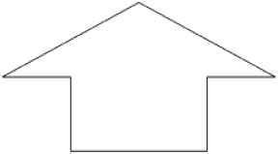


Hybrid architecture: Case 2
UA3
(2) Service requirement
UA1
SA
(3) Service delivery
(1) Multicast/Broadcast services
UA5
UA4
UA2
7. Juli 2009

Slide 12
Outline
Motivation
Open network
Discovery architectures
Service Location Protocol (SLPv2)
  Thread analysis SLPv2
Secure SLP
  Trust in open networks
  Security Groups
    Group Diffie-Hellman
  Thread analysis SecureSLP
Conclusion & Future Work
7. Juli 2009

Slide 13
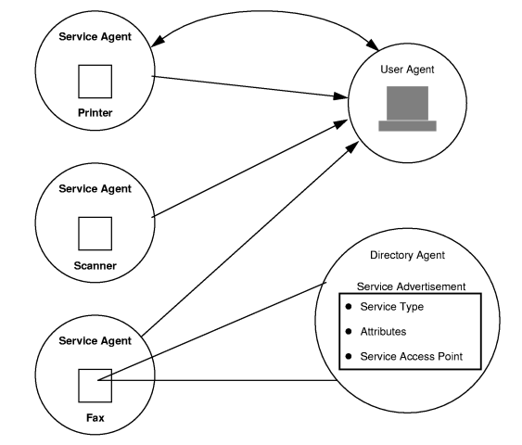
Service Location Protocol (SLPv2), RFC 2608
Multicast discovery
Unicast answers (UDP & TCP)
Seamless transformation from
  Multicast convergence to
  Directory Agent (DA)
    DA discovery still multicast
Partitioning via application layer
  Scopes
Trust with pre-established asymmetric keys
  no support for “dynamic” trust
7. Juli 2009

Slide 14
Thread analysis for traditional SLPv2
Confidentiality | no
Integrity | yes
Authentication | yes
Authorization | no
Replay prevention | no
Availability | no
Non-repudiation | no
7. Juli 2009

Slide 15
Outline
Motivation
Open network
Discovery architectures
Service Location Protocol (SLPv2)
  Thread analysis SLPv2
Secure SLP
  Trust in open networks
  Security Groups
    Group Diffie-Hellman
  Thread analysis SecureSLP
Conclusion & Future Work
7. Juli 2009

Slide 16
Trust in open networks
Web of trust
Public Key Infrastructure (PKI)
(Reputation based identity)
7. Juli 2009

Slide 17
Web of trust
If you trust A then you trust everyone trusted by A
Decentralized structure
  no extra server needed
Based on public-key cryptography
Sign keys which you trust
7. Juli 2009

Slide 18
Public key infrastructure (PKI)
Requires several instances
  Registration authority
  Certificate authority
  Validation authority
Based on public-key cryptography
Better with internet access
Centralized structure
  Requires a server
7. Juli 2009

Slide 19
Outline
Motivation
Open network
Discovery architectures
Service Location Protocol (SLPv2)
  Thread analysis SLPv2
Secure SLP
  Trust in open networks
  Security Groups
    Group Diffie-Hellman
  Thread analysis SecureSLP
Conclusion & Future Work
7. Juli 2009

Slide 20
Security Groups (SG)
SGs create a confidential channel among trusted peers (trust is pre-requisite)
SA2
UA2
UA3
UA1
SA3
Scope:
[default]
Scope:
[securityGroup]
DA
Carl
Multicast Group
7. Juli 2009

Slide 21
Security Groups (SG)
SGs create a confidential channel among trusted peers (trust is pre-requisite)
SA2
Group A
UA2
UA3
UA1
SA3
DA
Carl
Group B
Multicast Group
7. Juli 2009

Slide 22
Security Groups (SG)
Requirements
  unsecure channel
  decentralized architecture (?)
  peers do not know each other (?)
  dynamic group membership
  all participants agree on the same key
  key independence
    no past/future data is allowed to be decrypt-able by future/past group members
    Can be relaxed due to without SA joining, SG‘s data is stale
SGs boil down to Group Key Agreement protocol (GKA) like Group Diffie-Hellman
7. Juli 2009

Slide 23
Outline
Motivation
Open network
Discovery architectures
Service Location Protocol (SLPv2)
  Thread analysis SLPv2
Secure SLP
  Trust in open networks
  Security Groups
    Group Diffie-Hellman
  Thread analysis SecureSLP
Conclusion & Future Work
7. Juli 2009

Slide 24
Diffie-Hellman RFC2631 recap
Bob (UA)
Carl
Alice (SA)
x1
g
g
g
x2
g^{x1}
g^{x2}
g^{x1}
g^{x2}
g^{x2}
g^{x1}
key
foo
key
Notes:
Alice and Bob are assumed to know a public base colour- and there\u2019s no problem with Eve knowing this too. They then choose a private colour of their own, and combine some of that with the base colour to create a public mix. They can then send these mixtures to each other: Eve sees both public colours, but (since it\u2019s a lot harder to unmix paint), has no idea what private colours were used to produce them.
Having received each others\u2019 mix, Alice and Bob can then mix in their own private colour again, to produce a blend of three colours. But, each of them will have the same colour, since the order in which we mix paint is irrelevant. Eve, however, has no idea what this new mixture looks like.

Slide 25
Diffie-Hellman RFC2631 recap
Bob (UA)
random number = 4
2⁴ = 16
32
32⁴ = 1.048.576
Alice (SA)
random number = 5
2⁵ = 32
16
16⁵ = 1.048.576
common number (g): 2 (prime)
public keys (y1,y2) ~= 16, 32
private keys (x1, x2) = 4, 5
secret key = g^{(x1 * x2)} mod p = y^{x} mod p
7. Juli 2009
Notes:
ZZ = g ^ (y2 * y1) mod p = (x2 ^ y1) mod p = (x1 ^ y2) mod p
x1 is party 1's public key; x1 = g ^ y1 mod p
x2 is party 2's public key; x2 = g ^ y2 mod p
y1 is party 1's private key
y2 is party 2's private key
p is a large prime
q is a large prime
g = h^{(p-1)/q} mod p, where
h is any integer with 1 < h < p-1 such that h{(p-1)/q} mod p > 1
(g has order q mod p; i.e. g^q mod p = 1 if g!=1)
j a large integer such that p=qj + 1
(See Section 2.2 for criteria for keys and parameters)

Slide 26
Diffie-Hellman recap
2-party key exchange protocol
g^{x1}
Bob
Alice
x1
x2
g^{x2}
secret key = g^{x1x2}
7. Juli 2009
Notes:
g: is passed around as part of negotiation (a random number)
gx1: Bob‘s public key
gx2: Alice‘s public key

Slide 27
Asymmetric Group Diffie-Hellman (AGDH)
Group Leader
g,g^{x2}
Bob1 (UA)
Alice (SA)
x2
x1
g^{x1}, g^{x2}, g^{x1x2}, g^{x1x3}
Bob2 (UA)
x3
g,g^{x3}
secret key = g^{(x1 x2 x3)}
7. Juli 2009

Slide 28
Asymmetric Group Diffie-Hellman (AGDH) with Security Groups
Round 1: The group leader (SA), Ml announces the SG and its identity as part of the service description with traditional SLP
Round 2: Each interested M_{i} responds with a message which contains its identity and a “blinded” secret g^{ri} to SA
Round 3: SA collects all the received blinded secrets, raises each of them to its secret (rl) and sends them along with the original contributions to the group, i.e. it sends message which contains {g^{ri} , g^{ri * rl}} for all i 2M \ {l}
Key Calculation: Each M_{i} checks if its contribution is included correctly and obtains g^{rl} by computing (g^{ri rl})^{ri} -1
secret = g^{rl (1+∑ri)}
7. Juli 2009

Slide 29
Asymmetric Group Diffie-Hellman (AGDH) cont.
Key is composed of each peers contribution
  contrary to GKE where one peers sends the key to all participants
Join/Leave demands re-keying
  peers contribution is added/removed from the group key
One affects all
  compromise of a single group member affects the security of the whole group
(Perfect) Forward Secrecy (PFS)
  Compromise of long-term keys cannot result in the compromise of past session keys
7. Juli 2009

Slide 30
Outline
Motivation
Open network
Discovery architectures
Service Location Protocol (SLPv2)
  Thread analysis SLPv2
Secure SLP
  Trust in open networks
  Security Groups
    Group Diffie-Hellman
  Thread analysis SecureSLP
Conclusion & Future Work
7. Juli 2009

Slide 31
Thread analysis SecureSLP
 | SLP | SecureSLP
Confidentiality | no | yes
Integrity | yes | yes
Authentication | yes | yes
Authorization | no | ?
Replay prevention | no | yes
Availability | no | no
Non-repudiation | no | no
7. Juli 2009

Slide 32
Outline
Motivation
Open network
Discovery architectures
Service Location Protocol (SLPv2)
  Thread analysis SLPv2
Secure SLP
  Trust in open networks
  Security Groups
    Group Diffie-Hellman
  Thread analysis SecureSLP
Conclusion & Future Work
7. Juli 2009

Slide 33
Conclusion & Future Work
(SLP’s architecture qualifies it for use in open networks)
  hybrid architecture
SLP’s security features are not up to speed with open networks
  trust model is static
  no confidentiality
SecureSLP adds missing security features while staying protocol compatible to SLPv2
Group Diffie-Hellman a good candidate for security groups
  all peers knowing of each other might be too expensive
What about authorization, non-repudiation, availability?
Proof-of-concept implementation
  Asymmetric Group Diffie-Hellman & additions to SLP
7. Juli 2009

Slide 34

Questions
7. Juli 2009

Slide 35
References
[NetIP, Inc.] - http://www.netip.com/articles/keith/diffie-helman.htm
[P2PFound] - http://p2pfoundation.net/Free_and_Open_Network_Definition
7. Juli 2009

Slide 36
TODO
Final outline as separators between slides with highlight of current chapter
Total page numbers
References
Remove names from outline
Use Case
SecuredSLP Logo?
7. Juli 2009

Slide 37
Grundsätzliche Problemstellung
Trust (Identity) in Ad hoc/Mesh networks
  Service identity/authenticity
  Location based identity
Protokolle für geschlossene Netzwerke in der Wildnis
Matchmaking zwischen service discovery and service provider
  Third party service announcement
  (Unbekannte Servicetypen (SOA, Ontologien))
QoS und Performance/Verfügbarkeit
  Einschränkungen auf mobilen Geräten in Bezug auf SW-Ausstattung (Virenscanner, …)
  Batterie wird per DoS leer gesaugt
7. Juli 2009

Slide 38
Thread analysis of traditional SLPv2
Confidentiality
Integrity
Availability (DOS)
…
Replay prevention
I was a little bit astonished by the definition of the traditional security requirements in chapter 1.3. The CIA triad (traditional it sec requirement) is usally confidentiality, integrity and availability - how ever you list authorization, auhtentication, integrity and confidentiality. Only at the end of 1.3 you mention availability. This focus and choice seems rather unusual and important to me and i think it could be worth to elaborate on this in more detail.
Non-repudiation == Der Erhalt der der Daten kann nicht geleugnet werden
7. Juli 2009

Slide 39
Reputation base identity
(Subjective) classifies network users
  Availability
  Response time
  Rating
  etc...
Centralized structure
  Requires a server
06/28/09
7. Juli 2009

Slide 40
Why Secure Discovery/Motivation/Use Case
Abstrakte Beschreibung des UseCase
Motivation warum Secure Service Discovery nötig
Konkrete Anwendungen nennen
Was genau ist das Problem, das hier gelöst werden soll?
  Was ist ein Ad-Hoc Netzwerk?
  Warum möchte man so etwas haben?
  Welche (realistischen) Dienste könnten z.B. angeboten werden? Welche durch nicht-stationären Teilnehmern?
  Welche Angriffsszenarien bestehen?
  Welche Angriffsszenarien sind noch realistisch, wenn man die im Paper genannten Maßnahmen anwendet?
06/28/09
7. Juli 2009

Slide 41
What is an open network
Characteristics MANET/Open Network
AdHoc/Mesh Teil des Internets
  Erlaubt zentralistische Architekturen (bspw. CA) vs. dezentrale (p2p) Architektur im AdHoc/Mesh bei autarkem Netzwerk
User Interaktion notwendig
  Muss der User eingreifen und entscheiden, oder autonomes System?
IP & Wifi als Infrastruktur weit verbreitet
Dienste Anbieten und nutzbar machen durch:
  Service Location Protocol (SLP)
  (Multicast DNS (mDNS))
06/28/09
7. Juli 2009

Slide 42
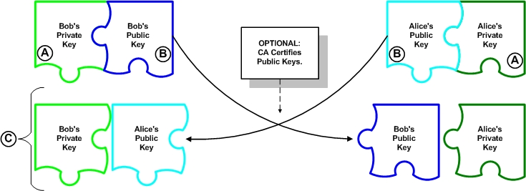
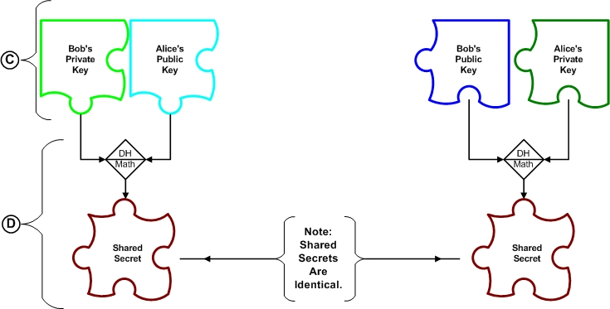
Diffie-Hellman RFC2631 recap
[NetIP, Inc.]
7. Juli 2009
Notes:
DH is not an encryption mechanism, but a method to securely exchange keys that encrypt data symmetrically
The public key is a derivative of the private key - the two keys are mathematically linked
Equivalent to discrete logarithms
cannot discern the private key from the public key
Web-of-Trust, CA (Certificate Authority) may be used to fight man-in-the-middle attacks
Shared Secret is asymmetric key by it mathmatical nature (key encryption key KEK), thus it will only be used to exchange a symmetric key (transport encryption key TEK)

